Slide 7
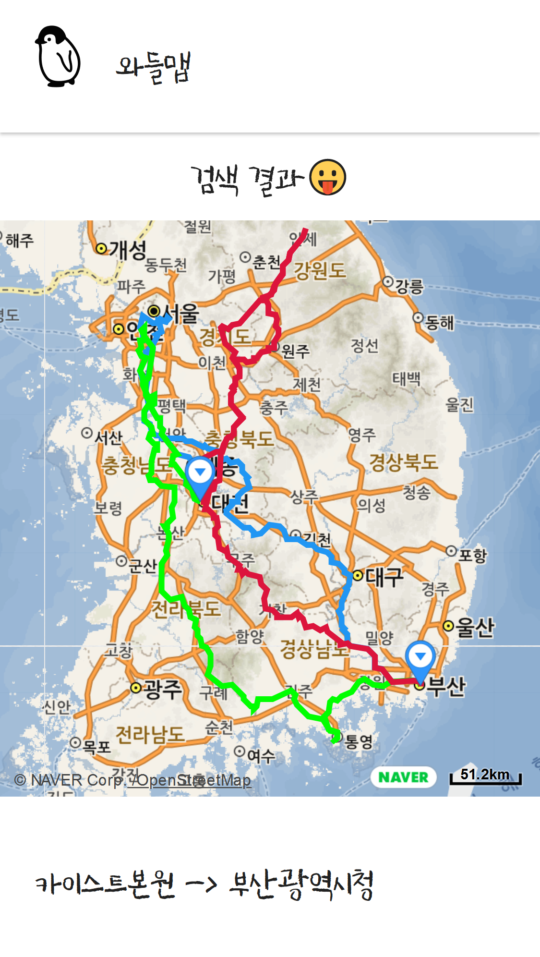

Slide 9
https://github.com/waddlecorp/Waddle-Map

